Slide 1

Getting Started With Git

Slide 2
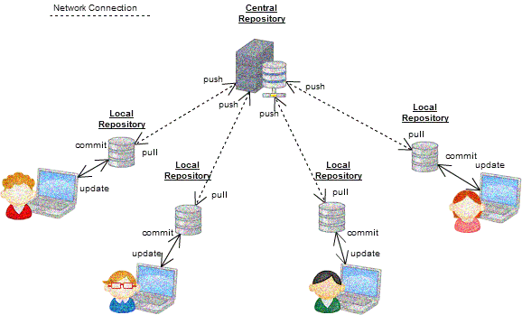
What is version control?
Version control systems are a category of software tools that helps in recording changes made to files by keeping a track of modifications done in the code.
The version control system keeps track of changes made in a particular software/code and takes a snapshot of every modification.
snapshot version indicates a view of the source code taken at a specific time.
E.g.:Let’s suppose a team of developer add some new functionalities in an application and the updated version is not working properly so as the version control system keeps track of our work so with the help of version control system we can omit the new changes and continue with the previous version.

Slide 3
Types of version control system
Local Version Control Systems: It is one of the simplest forms and has a database that kept all the changes to files under revision control.
Centralized Version Control Systems: Centralized version control systems contain just one repository globally and every user needs to commit for reflecting one’s changes in the repository. It is possible for others to see your changes by updating
Distributed Version Control Systems: Distributed version control systems contain multiple repositories. Each user has their own repository and working copy. Just committing your changes will not give others access to your changes.

Slide 4


What is Git?
Git is a distributed version control system tracking source code changes during software development. It is designed to coordinate work among programmers, but it can track changes in any set of files. Its goals include speed, data integrity, and support for distributed, non-linear workflows.
What is GitHub?
GitHub is a web-based Git repository hosting service, which offers all of the distributed revision control and source code management (SCM) functionality of Git as well as adding its own features.

Slide 5
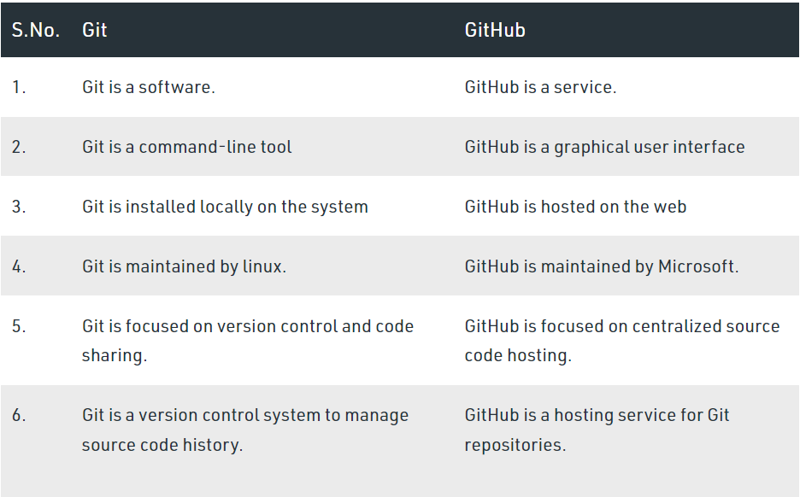
Git Vs GitHub

Slide 6
Features of GitHub
Repositories
Collaboration
Code review
Project management
Integrations

Slide 7
Features of GitHub
a-Repositories
b-Collaboration
A repository (or "repo" for short) is a collection of code and its associated version history. You can think of a repository as a folder that contains all of your code and its history
GitHub makes it easy for developers to work together on projects. You can invite other developers to collaborate on your repository, and use features like pull requests to review and merge code changes.
c-Code review
d-Project management
GitHub provides tools for reviewing and commenting on code changes. You can use pull requests to discuss changes with your teammates, and use the built-in code review tools to leave comments and suggestions
GitHub provides a range of tools for managing projects, including issue tracking, project boards, and team communication.

Slide 8
Things that we are looking at in GitHub:
Profile
Explore
What is a repository?
What are projects?
Branches (Main and others)
Pull requests and Issue

Slide 9
Important links
Create a GitHub account:: https://github.com/
Install GitHub Desktop:: https://desktop.github.com/
Installing Git: https://git-scm.com/
GitHub desktop guide: https://docs.github.com/en/desktop
Git Doc: : https://git-scm.com/doc/
Learn more about version control: https://www.geeksforgeeks.org/version-control-systems/
Some tutorials for better understanding:
Hindi: https://www.youtube.com/watch?v=NR_A2gCxaLE&t=1357s
Operating Git using the command line: https://www.youtube.com/@freecodecamp

